Slide 1



K S SCHOOL OF ENGINEERING & MANAGEMENT BENGALURU-560109
(Affiliated to VTU, Belagavi & Approved by AICTE, New Delhi, Accredited by NAAC)
D EPARTMENT OF ARTIFICIAL INTELLIGENCE & DATA SCIENCE
DEPARTMENT OF ARTIFICIAL INTELLIGENCE & DATA SCIENCE
PROJECT WORK (21ADP76)
TITLE:
DIABETES PREDICTION USING MACHINE LEARNING
Group No : 1
Date : 29/05/2025
NAME USN
UNDER THE GUIDANCE
Hema B 1KG21AD013
Monika S 1KG21AD031
Sinchana T 1KG21AD046
Vandana C 1KG21AD056
Dr. Manjunath T. K
Professor, HOD
Dept., of AI & DS, KSSEM

Slide 2
CONTENT
Introduction
Problem Statement
Objectives
UI/UX
Over Result
Application and Deployment
Conclusion

Slide 3
INTRODUCTION
Diabetes is a chronic disease that affects how the body processes blood sugar (glucose). Early detection is essential to prevent severe complications like heart disease, kidney failure and nerve damage.
Machine learning offers an efficient way to analyze patient health data and predict diabetes risk.

Slide 4
PROBLEM STATEMENT
After receiving their medical reports, patients often face long waiting times at hospitals or clinics for their turn, which can be particularly challenging for elderly patients or those with severe diabetes complications. This delay can lead to discomfort, increased health risks and inefficient use of healthcare resources.

Slide 5

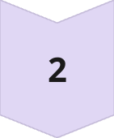
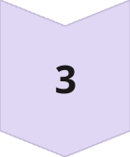
OBJECTIVES
Data Collection And Preprocessing
Algorithm Selection and Model development
Testing and Evaluation of Model

Slide 6
1. Data Collection and Preprocessing
Dataset obtained from: IEEE research papers, Kaggle, UCI Machine Learning Repository, and GitHub
Records: Over 80,000 entries
Features included: Plasma Glucose, BMI, Blood Pressure, Age, Pregnancies, Diabetes Pedigree.
Data cleaning steps: Missing values handled, outliers capped, features normalized using Min-Max scaling, and dataset balanced using SMOTE.

Slide 7
2. Algorithm Selection and Model Development
Evaluated multiple classification algorithms for performance
Selected top-performing models:
Random Forest (RF)
Decision Tree (DT)
K-Nearest Neighbors (KNN)
Combined using a Stacking Classifier
Base models: RF, DT, KNN
Meta-learner: Logistic Regression
Ensemble improved accuracy over standalone models

Slide 8
3. Training and Evaluation of Model
Accuracy Evaluation: Measures overall correctness of predictions
Confusion Matrix: Visualizes TP, TN, FP, and FN to assess performance
Precision, Recall, F1-Score:
Precision: Correct positive predictions / Total predicted positives
Recall: Correct positive predictions / Actual positives
F1-Score: Harmonic mean of Precision and Recall
Cross-Validation:
Ensures model generalization across multiple data splits
Reduces bias from a single train-test split

Slide 9
UI/UX
Frontend : Simple and intuitive interface
Technology Used : Python, Tkinter (GUI).
Users can:
Input personal medical data.
Get instant prediction (Diabetic / Pre-Diabetic / Non-Diabetic).
Interface designed for ease of use by patients.

Slide 10
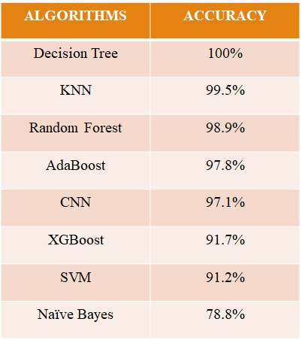
OVER RESULTS
We deployed the Best–Performing Ensemble model of KNN, Decision Tree, Random Forest.
The Accuracy of the model is 99.6%.

Slide 11
APPLICATION and DEPLOYMENT
Community Health Screening
Personal Health Monitoring
Healthcare Awareness Programs
Telemedicine and Remote Healthcare
Patient Self-Management
Healthcare Research and Data Collection

Slide 12
CONCLUSION
This project successfully demonstrated the power of machine learning in early disease prediction. The Ensemble model achieved exceptional performance. The deployment makes the tool usable for real-world medical scenarios, reducing delays and improving patient prioritization. Future enhancements could integrate real-time wearable data and multi-disease prediction systems.

Slide 13
THANKYOU

